Slide 1

Information Integration – Exercise 5
Daniel Neuschäfer-Rube, Jaqueline Pollak,
Jakob Reschke, Lars Rückert
01.02.2016
Notes:
Remember: Topic Politicians and Books

Slide 2
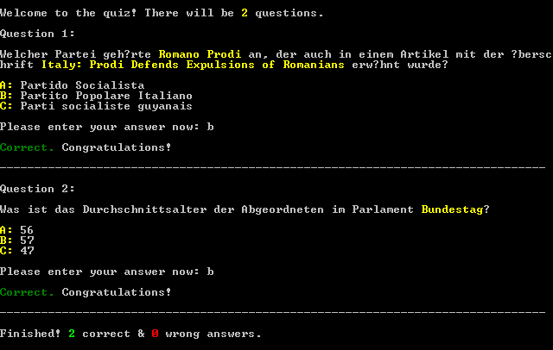
Quiz - Application
Notes:
Type: Statistics, Data mining
Idea: Fact Extraction
Topic Politics and Books/Articles
Thanks to team Christoph, who gave us the idea to create a game/quiz.

Slide 3
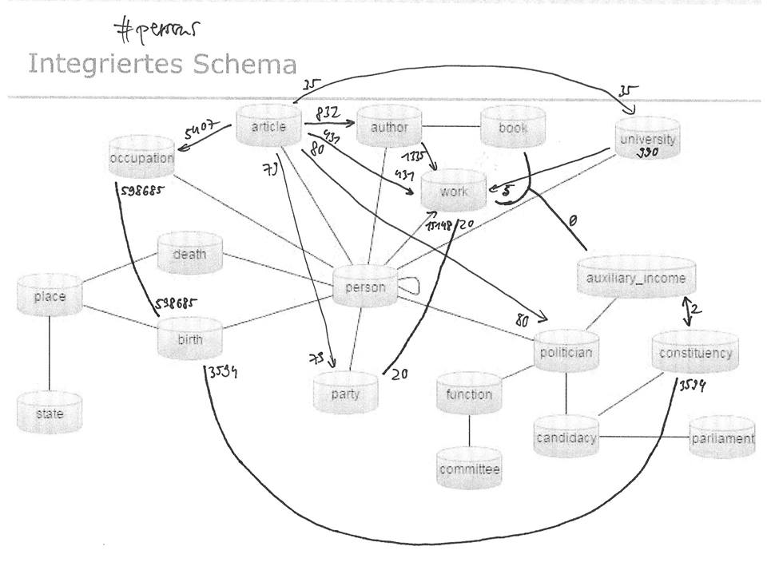
Notes:
Do the different dataset really integrate? yes
Can you jointly integrate data from all datasets? Yes, but some have insufficient tuples for analysis
Can you answer queries that no individual dataset could answer? Yes, e.g. party <-> article
aber Überschneidungen zwischen Datensätzen so klein (Anzahl Personen), dass kaum/keine repräsentativen Allgemeinaussagen ablesbar sind

Slide 4
Validation
Which integration decisions turned out to be good or bad?
For some persons: insufficient information → wrong matches
E.g. Informatiker Andreas Kunert (1619-1622)
Can you query the information you need efficiently?
Efficiency vs too many NULL values
What data quality do you observe?
Mostly correct / reasonable answers
Improvement for dbpedia source: We would have exported more attributes if we had known they would be useful (e.g. gnd_id)
If we had known what to do with the data beforehand, we might have chosen different datasets
Notes:
Did you loose any important data or metadata? No.

